Slide 1
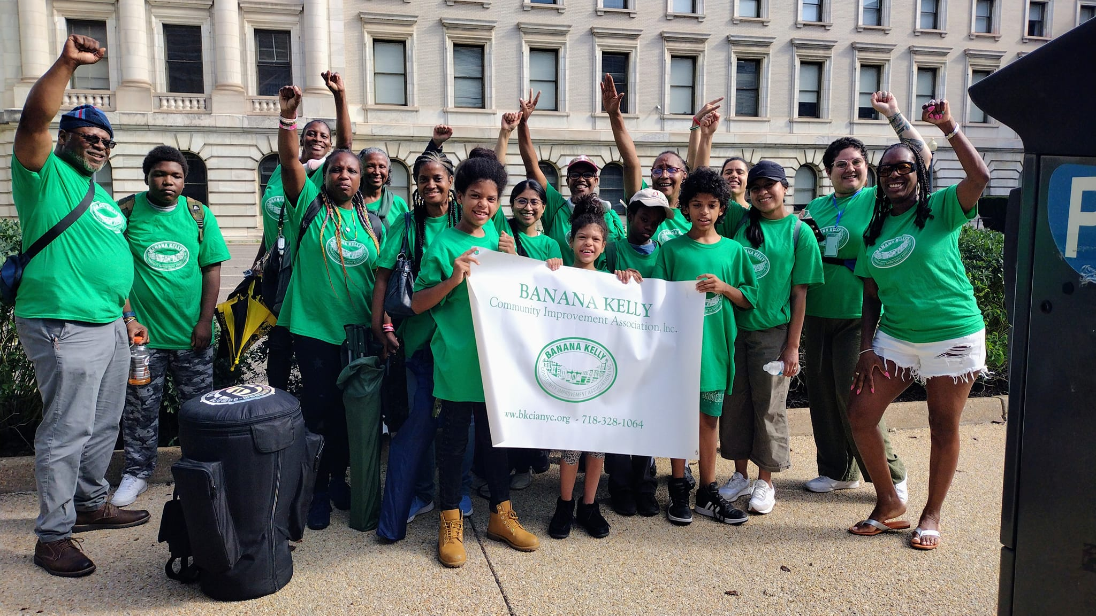

BANANA KELLY CIA 2024 ANNUAL REPORT

Slide 2
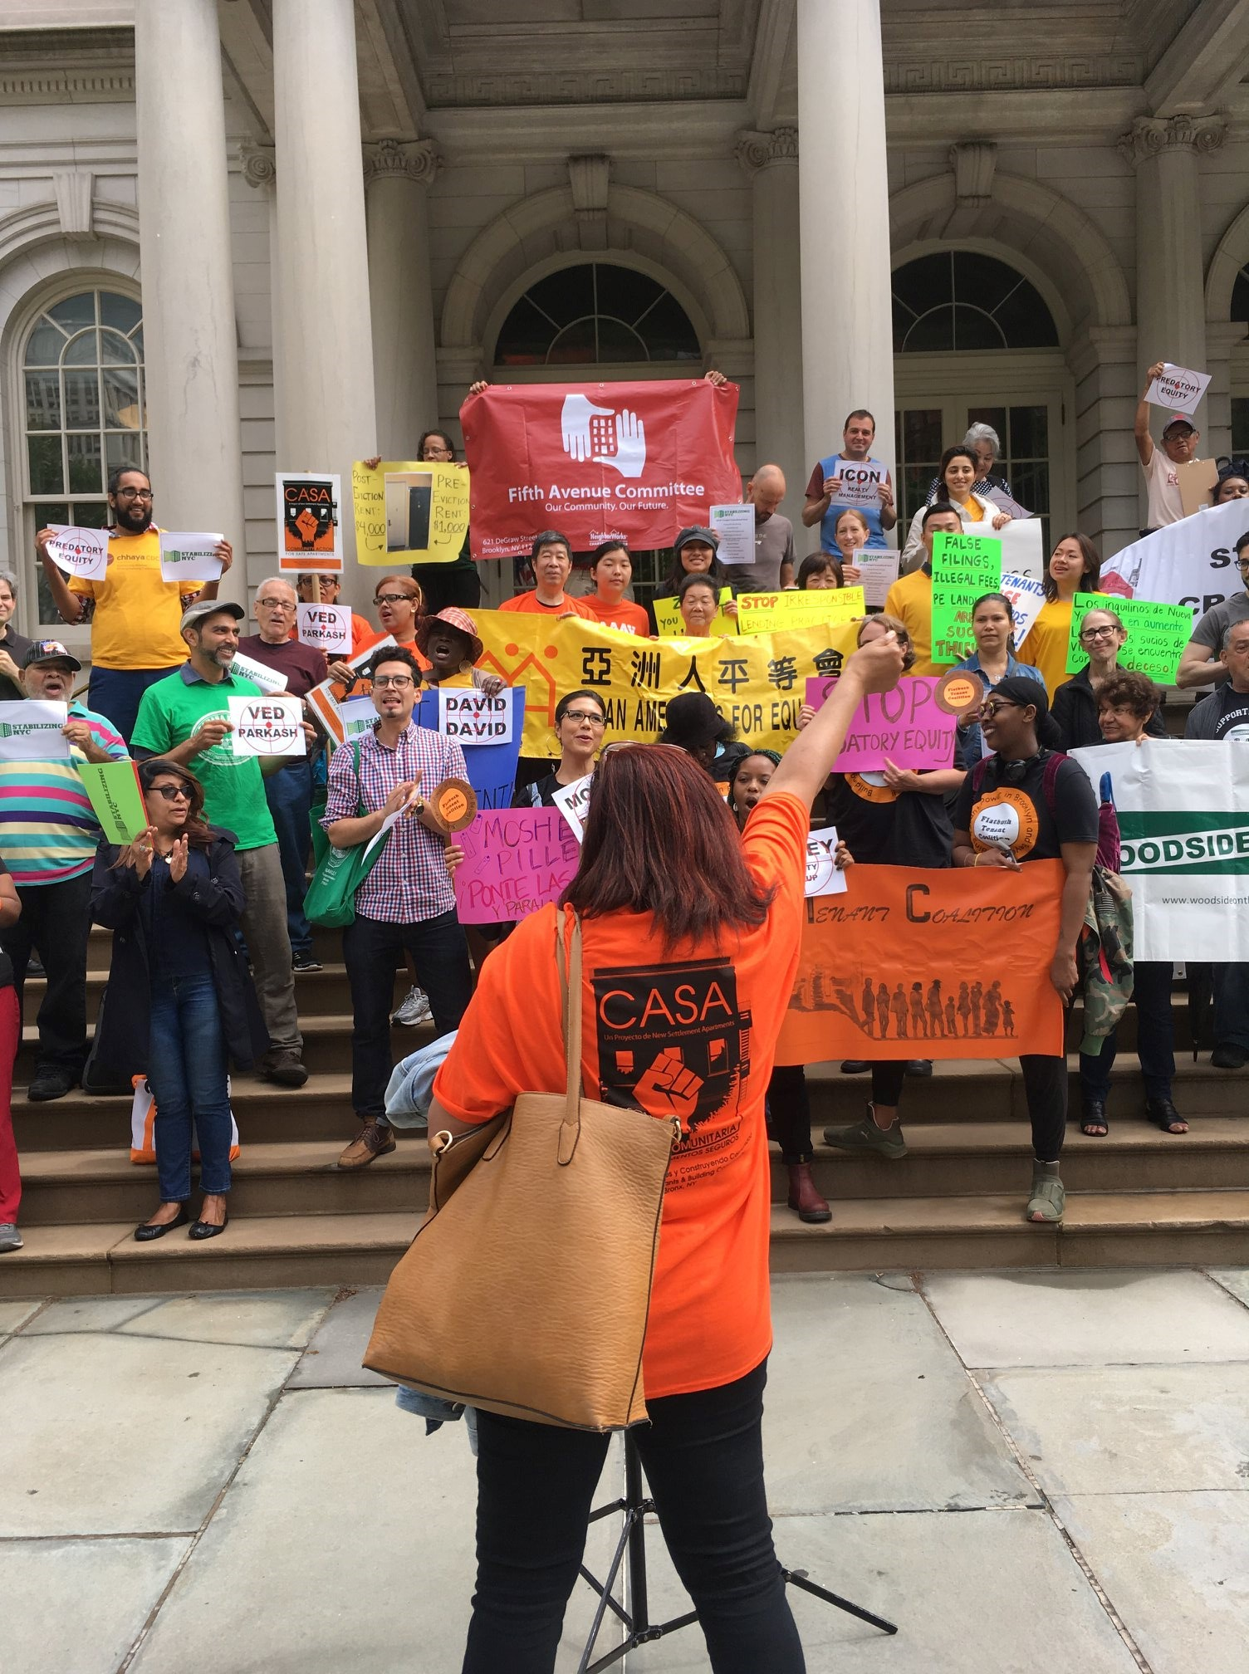
CONTENTS
Mission Statement & Vision . . . . . . . . . . . . . . . . . . 3
Affordable Housing
Former Cluster Site Buildings, Third Party Transfer, ANCP Cluster . . . . . . . . . . . . . . . . . . . . . . . . . . 5
Joe Interval Cluster, East Harlem El Barrio CLT Cluster. . . . 6
Human Services & Organizing
Case Management Services, Rental Assistance Program. . . . . . . . . . . . . . . . . . . . . . . . . . . . . 8
Resident Council, The NYC Civic Engagement Commission. . . . . . . . . . . . . . . . . . . . . . . . . . . 9
Community Organizing. . . . . . . . . . . . . . . . . . . . . 10
Special Initiatives
Youth Education Program (YEP), Healthy Communities. . . . . . . . . . . . . . . . . . . . . . . . . . 12
Stabilizing NYC, Mobile Credit Union Van . . . . . . . . . . 13
Funders & Supporters

Slide 3
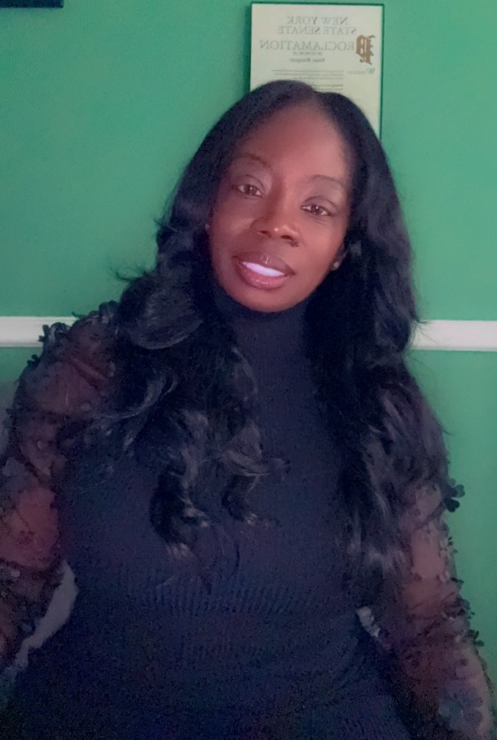
MISSION STATEMENT & VISION:
Banana Kelly Community Improvement Association contributes to a revitalized, safe and economically vibrant South Bronx through the development and management of affordable housing and provision of targeted human services. Banana Kelly works to preserve affordable housing and keep people in it by:
Preserving and expanding the supply of safe, affordable housing;
Creating the opportunity for resident governance and community control;
Providing supportive services that enable resident empowerment and community restoration; and,
Supporting local investment in the community.
Our Staff works with people who are living under the threat of displacement, or who have been displaced, who live, work or spend significant amounts of time in Bronx Community Districts 1, 2, 3 and 4. Our residents and clients are typically some combination of low income, low wealth/assets, low educational level, and/or a disability. The vast majority of our residents and clients are people of color.
Hope Burgess, President & CEO
BANANA KELLY CIA 2024 ANNUAL REPORT

Slide 4
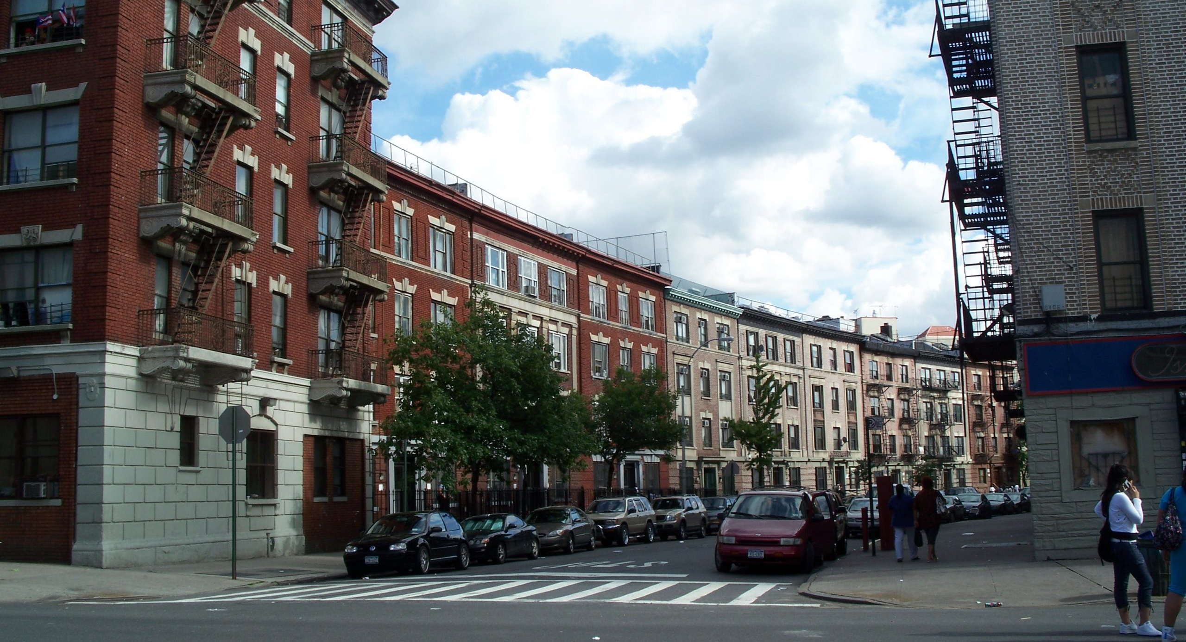
AFFORDABLE HOUSING
Since our inception, Banana Kelly Community Improvement Association have sponsored the redevelopment of over 2,900 units of housing, over 1,700 of which remain under our sponsorship. In addition to providing affordable housing, Banana Kelly’s developments often include features including affordable commercial space, supportive services, day care centers, community rooms, and children’s play areas. Following the consistency and quality of developments we provide our community, opportunities to expand our affordable housing portfolio has expanded.
BANANA KELLY CIA 2024 ANNUAL REPORT

Slide 5
Former Cluster Site
ANCP – 311 Pleasant Avenue Cluster
In 2020, the BK Cluster Site – 941 Intervale, 976 Tinton, 1315 Lafayette and 911 Simpson, were slated to transition from pre-development to construction loan closing in order to begin the rehab. After delays due to COVID, rehabilitation of 941 Intervale and 976 Tinton began in the Summer of 2021, completing their rehab phase in 2023.
After beginning construction on 1315 Lafayette and 911 Simpson in late 2023, significant progress in their rehabilitation was made in 2024.
The two buildings in our BK ANCP Cluster—51-55 E. 129th Street and 1263 Park Avenue—contain a total of 40 apartments. Like the TPT buildings, our initial plan was to complete pre-development work and proceed to construction loan closing in 2020, followed by substantial rehabilitation. However, due to COVID-19, the closing was delayed.
The rehabilitation will adhere to Enterprise Green Communities standards and HUD Section 504 requirements for handicap accessibility. A few apartments will be specifically outfitted for mobility-impaired residents, as well as one for a sensory-impaired resident. Upgrades will include new bathrooms and kitchens, along with all-new finishes, plumbing, heating, electrical systems, and a full sprinkler system with fire alarms. Additionally, the scope of work includes critical exterior renovations.
On December 24, 2024, we successfully transitioned the project from pre-development to construction loan closing, with work set to begin in early 2025. In early 2024, a third building—311 Pleasant Avenue—was removed from the portfolio, streamlining the closing process. Construction is expected to take 18 to 24 months, extending into 2027.
Third Party Transfer
Several years ago, the City’s Department of Housing Preservation and Development invited us to take over four foreclosed properties. Through the City’s Third Party Transfer program, we assumed management, stabilized the buildings, and initiated pre-development efforts.
In 2024, due to delays in the pre-development phase, all parties agreed it would be more efficient to incorporate these buildings into a larger rehabilitation project. This initiative includes Banana Kelly’s core portfolio of over fifteen buildings, which have not undergone rehabilitation in more than two decades. Our goal is to upgrade key building systems, kitchens, restrooms, and other essential elements as needed. Together with HPD, we are actively collaborating with partners to secure financing for this expanded development effort.
.
BANANA KELLY CIA 2024 ANNUAL REPORT

Slide 6
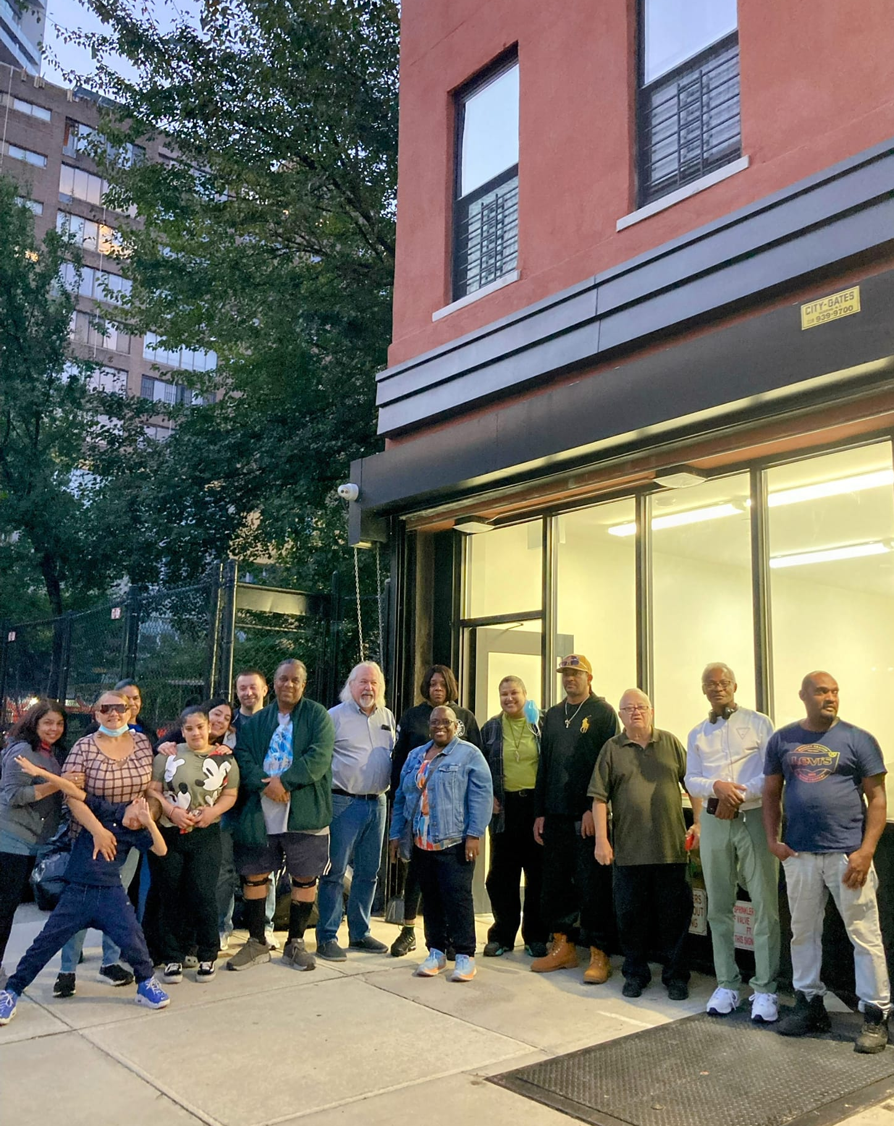
East Harlem El Barrio CLT
Since 2019, Banana Kelly has collaborated closely with the East Harlem El Barrio Community Land Trust to develop additional housing and establish a tenant-controlled mutual housing association as the future building owners.
In 2023, two buildings within this four-building portfolio successfully completed substantial rehabilitation. In the summer of 2024, construction began on 304 E. 121st Street. Over the last six months of the year, significant progress was made in strengthening the building’s structural integrity, stairwell, heating, and rain drainage systems.
We plan to commence rehabilitation of the remaining building, 204 W. 121st Street, in 2025.
BANANA KELLY CIA 2024 ANNUAL REPORT

Slide 7
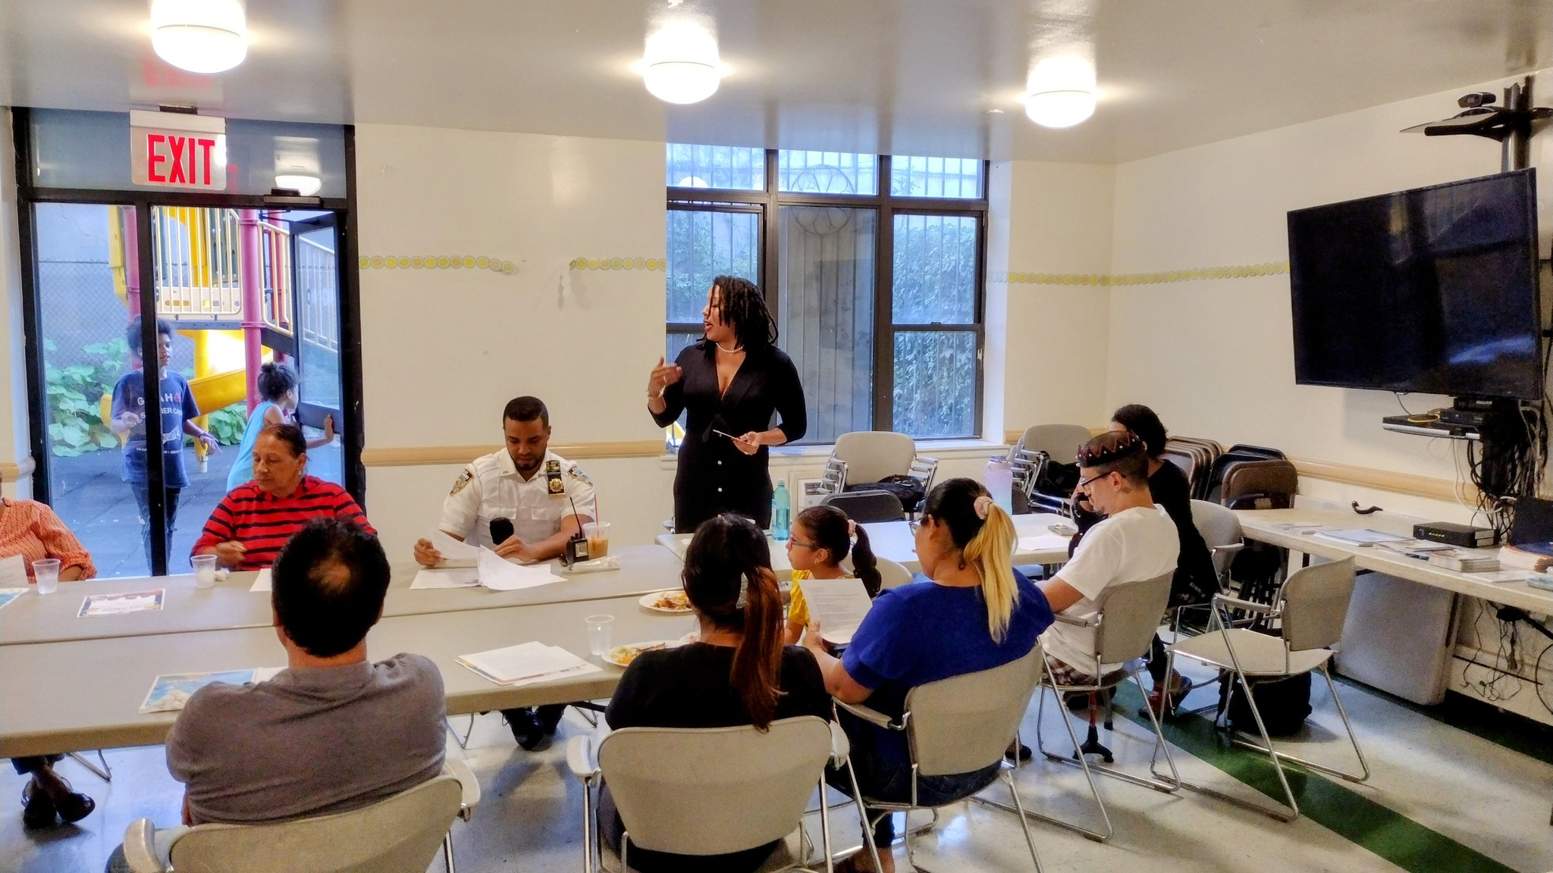
HOUSING SERVICES & COMMUNITY ORGANIZING
Since our inception in 1977 (and incorporation as a non profit in 1978) Banana Kelly has been a bulwark against predatory practices that threaten the sustainability and expansion of low income housing in the South Bronx. This fight has always utilized a grassroots model of engaging with, developing, learning from, and advancing the community visions of local residents. This vision is what shaped Banana Kelly and it is what propels us today.
BANANA KELLY CIA 2024 ANNUAL REPORT

Slide 8
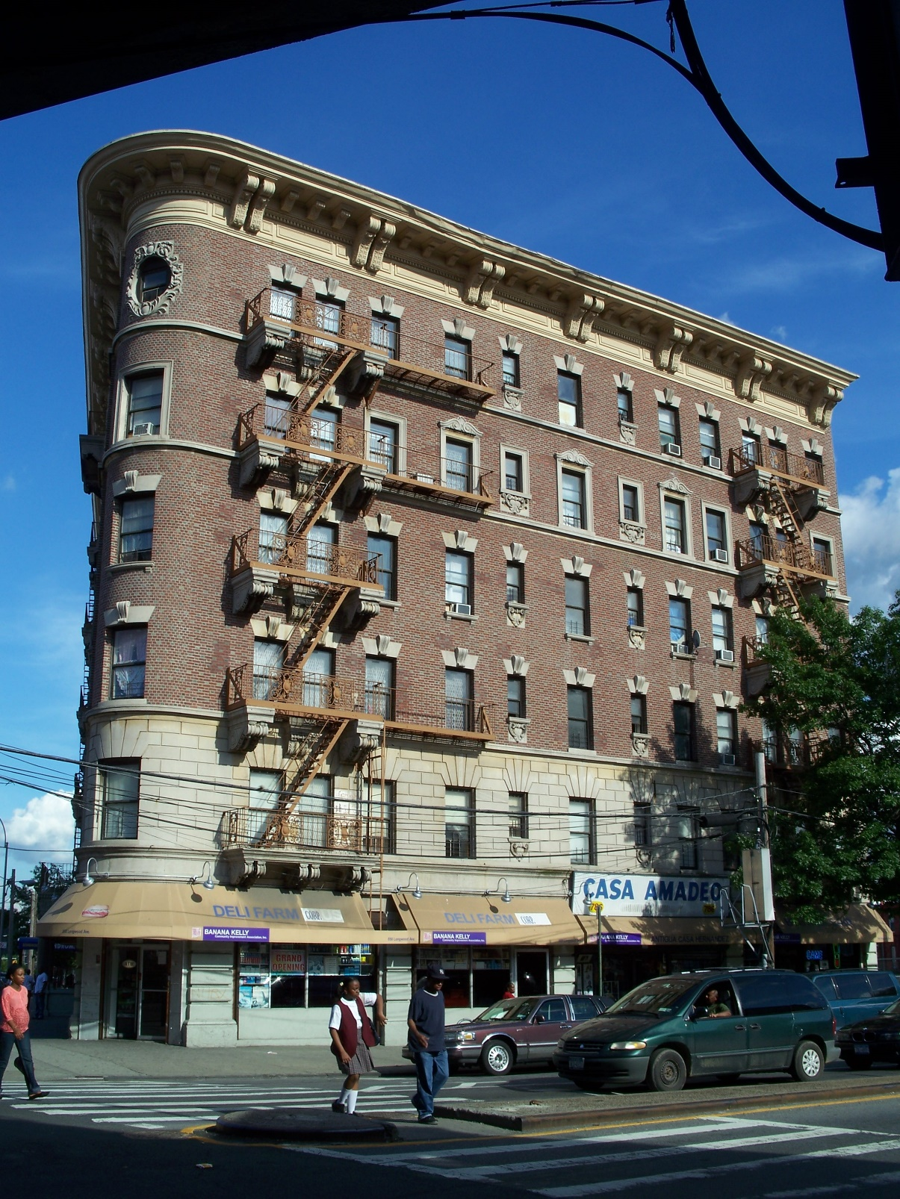
Case Management Services
We increased our Case Management services to support our most vulnerable residents in maintaining their homes. In 2024, our staff assisted thousands of South Bronx and Northern Manhattan residents affected by the lasting impacts of COVID-19, the effects of the new immigrants arriving to the city and rising cost of living. Through rental assistance programs, supportive services, and various government and private resources, we helped stabilize their living situations.
Throughout the year, we provided critical support to hundreds of residents struggling with rent arrears due to the pandemic and other financial hardships. We guided them through applications for the Emergency Rental Assistance Program and One Shot Deals, offering much-needed relief and peace of mind by securing government financial aid to cover a portion of their overdue rent.
Rental Assistance Program (RAP)
Our Supportive Housing Rental Assistance Program (RAP), is funded by the US Department of Housing and Urban Development, continued to support homeless and disabled individuals, through both a rental subsidy and a supportive services component.
During 2024 we assisted over 36 families, over 100 community members.
BANANA KELLY CIA 2024 ANNUAL REPORT

Slide 9
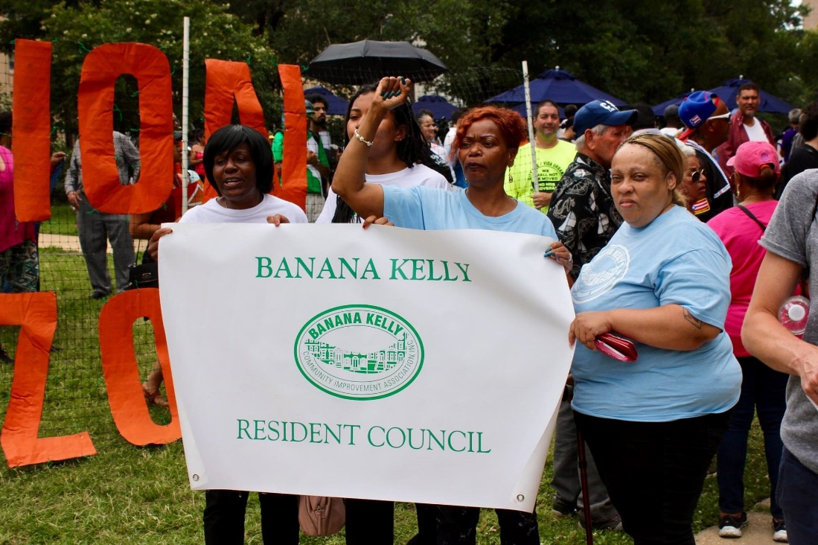
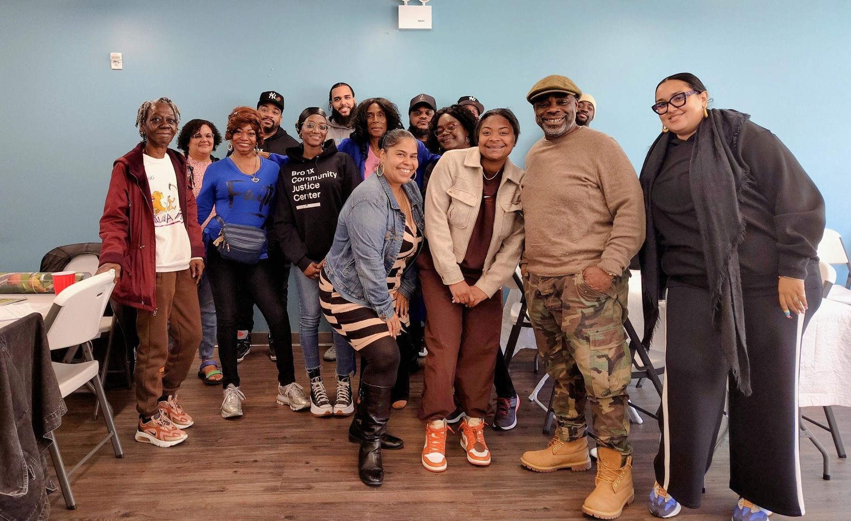
Resident Council
As a mutual housing association, we believe in fostering a strong Resident Council (RC) that drives our organizing efforts and cultivates leadership within our community. Too often, residents—particularly those in the South Bronx—are perceived as powerless in shaping their own future. The Banana Kelly Resident Council was established to challenge this notion and empower residents to take an active role in decision-making.
The RC serves as a vital platform for residents to regain control over their lives. By determining their own priorities and strategies, residents take the first crucial step toward building a stronger voice and reclaiming their power.
In 2024, the Resident Council met on the first Tuesday of each month to discuss programs and initiatives aimed at increasing community engagement and participation.
The NYC Civic Engagement Commission
In 2024, Banana Kelly’s community organizers led multiple resident council meetings focused on the Civic Engagement Commission’s Participatory Budget Campaign, The People’s Money, which aims to fund community-based ideas in 2025 and beyond. After ideas are developed and proposed, they are evaluated by The Bronx Borough Assembly Committee and chosen for funding based on their feasibility, need, costs, impact based on community assessments and expert input. Finally, the selected projects will be on the Participatory Budget (PB) ballot for a vote.
BANANA KELLY CIA 2024 ANNUAL REPORT

Slide 10
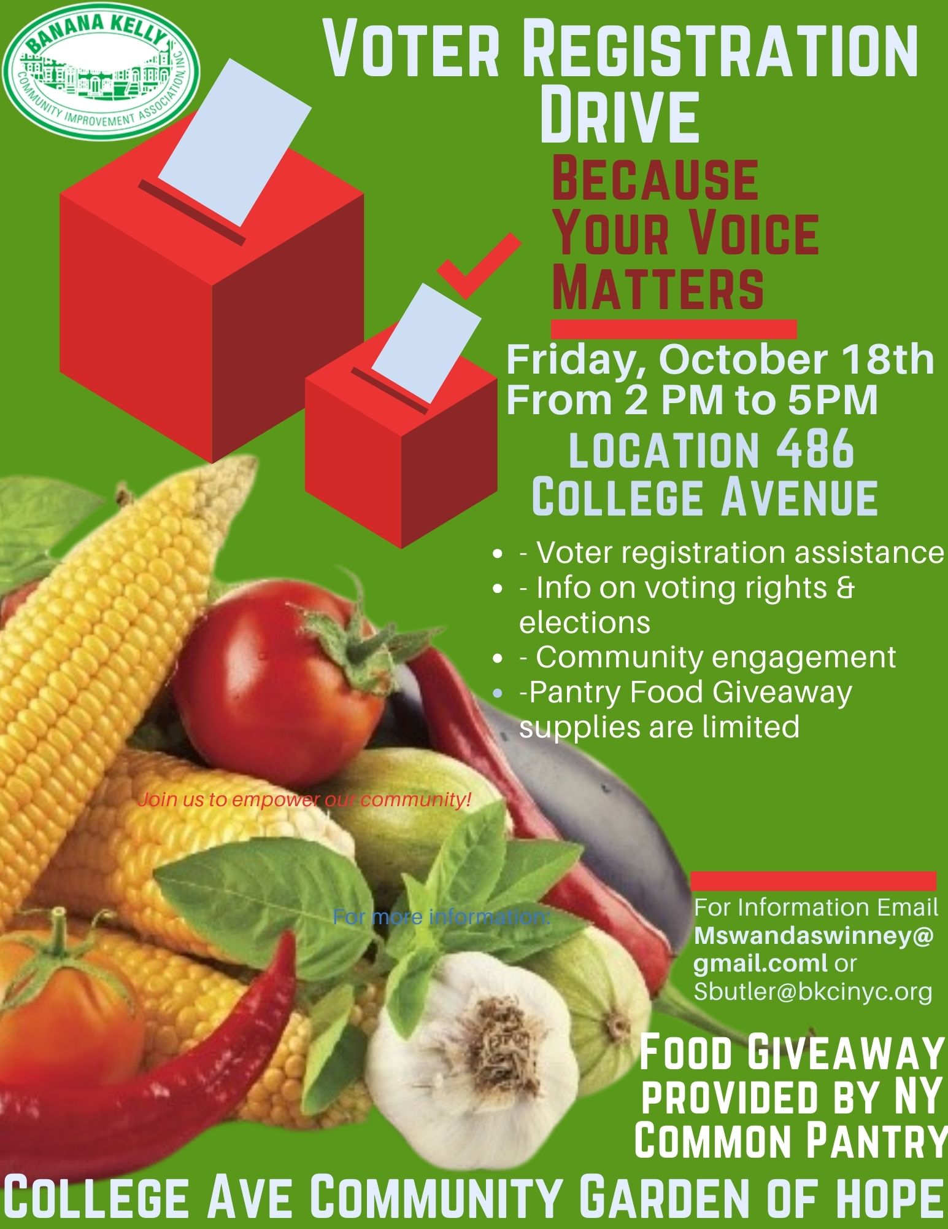
2024 Voter Registration Drive
Community organizing is a cornerstone of effective nonprofit work, empowering individuals and groups to come together, address shared challenges, build collective power, and drive meaningful change. With the unique opportunities presented during election years, 2024 was particularly significant for Banana Kelly’s ongoing commitment to fostering civic engagement and participation.
In preparation for the 2024 U.S. Presidential election, Banana Kelly actively provided voting guides to the community, ensuring residents had access to essential information. Hosting Voter Registration Drives was a key initiative, offering voter education and registration assistance—an especially critical effort in serving the historically underrepresented South Bronx community.
BANANA KELLY CIA 2024 ANNUAL REPORT

Slide 11
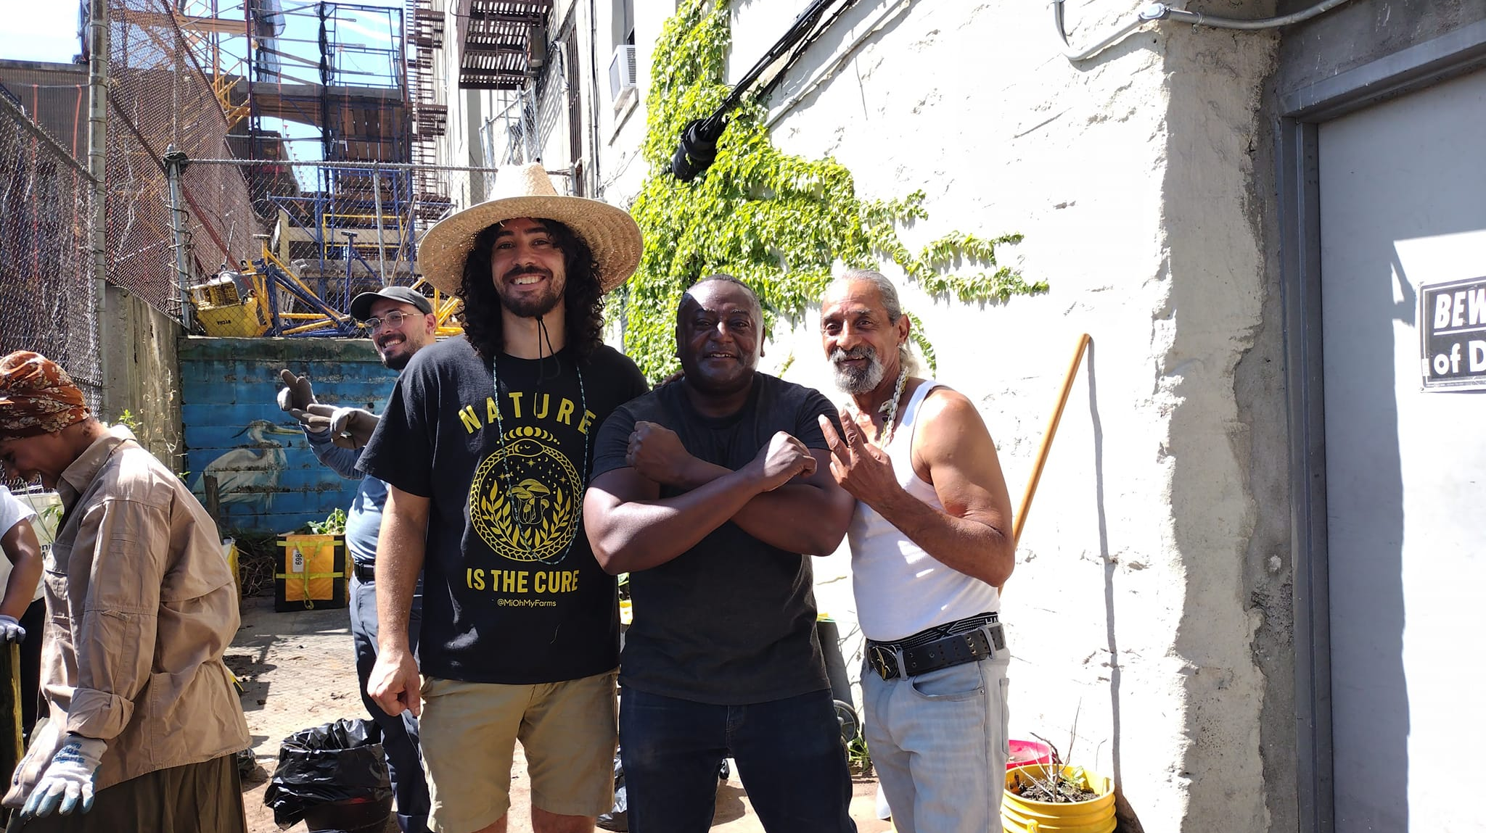
SPECIAL INITIATIVES
In addition to our work that focuses on our key program areas, Banana Kelly Community Improvement Association takes on projects dedicated to specific goals that often incorporate a variety of our expertise.
BANANA KELLY CIA 2024 ANNUAL REPORT

Slide 12
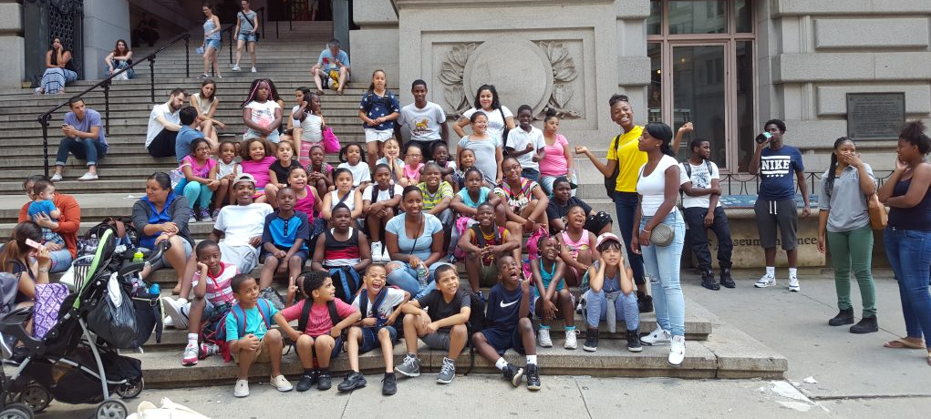
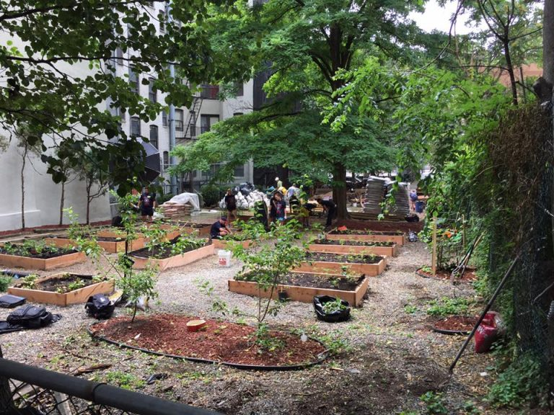
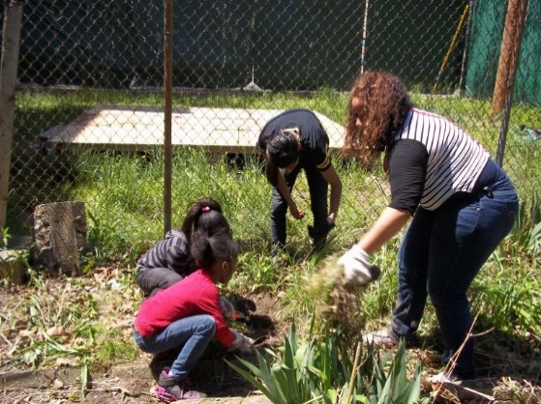
Youth Education Program (YEP)
Healthy Communities
Our Youth Education Program consists of two connected programs – Summer Camp Program and After School Program. The camp is designed to expose youth to new experiences through trips to museums, botanical gardens, community gardens, sports arenas, and historical sites, offering a blend of fun and educational opportunities. The goal of YEP is to increase student retention and on-time graduation rates and to enhance appreciation for learning and self-motivation.
The After School Program is designed to: (1) provide an outlet for a safe, productive, after school experience that supplements and complements in-school lessons; and (2) provide venues for homework completion, independent study, and group achievement.
The Healthy Communities Initiative was established in 2012 to create new and improved healthy food outlets and venues for our residents. In addition to increasing access to healthy and affordable food, the initiative builds community, helps restore the social fabric (including through intergenerational connections), and increases the distribution of healthy foods (some grown locally), reducing our carbon footprint. The program also mobilizes residents to work against barriers to community health while spurring new opportunities for creativity and entrepreneurship.
Some of the key highlights from 2024 include distributing over 82,000 lbs. of food to more than 8,000 South Bronx residents and growing 1,800 lbs. of vegetables in affiliated gardens. Additionally, we signed an agreement with Mi Oh My to provide workshops and demonstration projects on Micro Gardening techniques. Mi Oh My has now established its presence in our indoor space at 970 Prospect Avenue. In the spring and summer of 2025, Mi Oh My will be organizing a variety of events, including cooking demonstrations, interactive activities, and community meetings focused on broader health-related issues, all taking place in the garden at 970 Prospect Avenue.
BANANA KELLY CIA 2024 ANNUAL REPORT

Slide 13
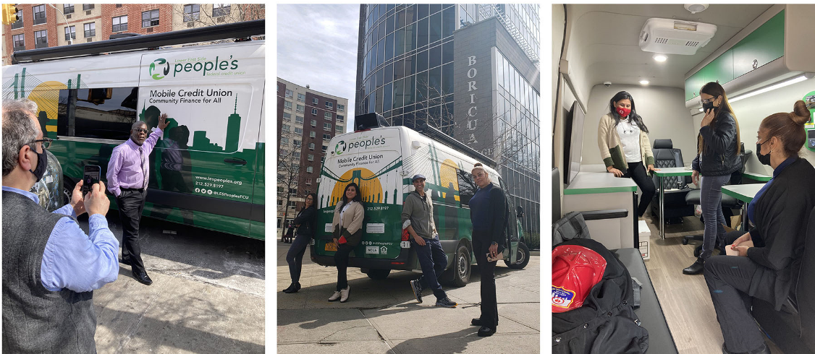
Stabilizing NYC
Mobile Credit Union Van
Stabilizing NYC is a citywide coalition that combats the loss of affordable housing units at the hands of predatory equity companies and defends low-income residents from harassment and eviction. This coalition consists of 17 grassroots organizations from across the five boroughs, a research organization, and a legal services provider.
Last year, from May 2024, BKCIA was involved in creating new tenant associations in 643 Southern Blvd, 945 East 163rd Street, 676-686 Beck Street, 923 Simpson, and 563 Cauldwell Avenue. Aside from the last, All of these buildings have had legal providers such as Legal Aid Society and Bronx Legal Services brought within the building to assist with demand letters and both 945, 643 have had meetings with their management. As well as attending Banana Kelly community events and Resident Council meetings.
Along with those buildings, which are still active as of today, outreach was conducted at 663-665 Dawson, 245 Willis Avenue, 260 Brook Avenue, 1114 Ward Avenue, 1133 Boston Road, 536/533/537 Tinton Avenue, 1321 Seneca Avenue, 876 Bryant Avenue, 1001 Home Street, 864 E 149th Street, 797 E 142nd St, and several more. Though these buildings had either low tenant participation or no want to organize so they have been classified as inactive.
Partnering with 3 other local community development corporations and with the Lower East Side People’s Credit Union, Banana Kelly launched a mobile van bringing the opportunity to join a credit union directly to the residents of our community. Our South Bronx community has a long history of limited access to banks, forcing our residents to utilize other methods of banking such as check cashing businesses to pay bills, obtain money orders and case checks.
Working with Webster Bank and the Lower East Side People’s Credit Union we are providing the opportunity for our residents to create and manage their financial health. Since we began this year we have provided information and literature to hundreds of residents, with dozens opening bank accounts. In 2024 the groups were instrumental in facilitating the opening on the first LESPCU brick and mortar location in a Banana Kelly building located at 941 Intervale Avenue. Grand Opening was in December 2024.
BANANA KELLY CIA 2024 ANNUAL REPORT

Slide 14















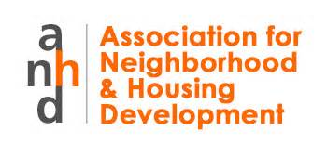




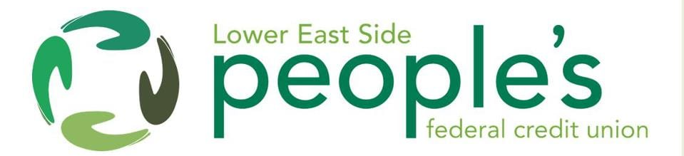
SPONSORS & SUPPORTERS
Banana Kelly Community Improvement Association acknowledges and appreciates the support it receives from its range of individual and corporate partners
Karen Backus & Alan Goldberg | Diane and Blum | Jason Boroff | Bernard Carr | Harry DeRienzo | Marc Jahr | Lynette Verges | Don Damon | Robert Samuels | Lee Allen | Guide Fabrics | Tony Won/Brian Sahd | Carlos Mieles | Rowan Creary
BANANA KELLY CIA 2024 ANNUAL REPORT

Slide 15
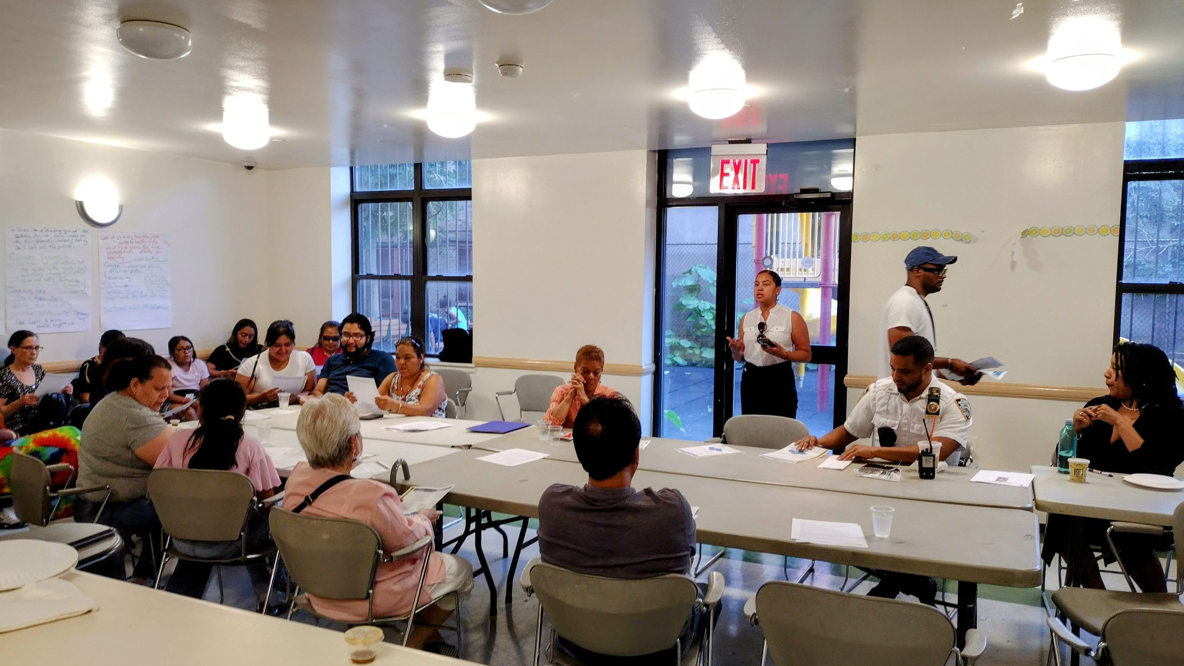
THANK YOU
Thank you all for your support and participation, we look forward to working with you in 2025 – and in the years ahead.
BANANA KELLY CIA 2024 ANNUAL REPORT
Banana Kelly Community Improvement Association, Inc.
863 Prospect Avenue, Bronx, NY 10459. 718.328.1064 info@bkcianyc.org
Join us on facebook/bananakelly -- twitter/bkcianyc – Instagram/bananakellybx

